Slide 1
EE451: High Voltage Engineering
Lecture 8
May 23, 2016

Slide 2
Outline
Breakdown Mechanism in Gases
Introduction
Air as insulating medium
Energy band theory
Ionization by collision
Photo-ionization
Secondary ionization processes
Page 2

Slide 3
Introduction
In high voltage apparatus, the suitability of application of gaseous dielectrics depends upon their physical, chemical, and electrical properties.
Gaseous dielectrics are classified into two main groups:
Electro-positive gas (tendency to give up electrons forming positive ions)
Electro-negative gas (capable of absorbing free electrons forming negative ions)
The most widely used gaseous dielectrics:
Atmospheric air
Pure nitrogen (N₂), that is, an electropositive gaseous dielectric
Sulphurhexaﬂuoride (SF₆ ), that is, an electronegative gases
Page 3

Slide 4
Introduction
There are many other gases which have found use but to a limited extent in high voltage insulation techniques. For example:
Oxygen (O₂)
Hydrogen (H₂)
Carbon dioxide (CO₂)
Helium (He)
Neon (Ne)
Carbon tetrachloride (CCl₄)
Sodium vapour (Na) diﬂuorodichloro methane (CCl₂F₂), also known as Freon etc.
Page 4

Slide 5
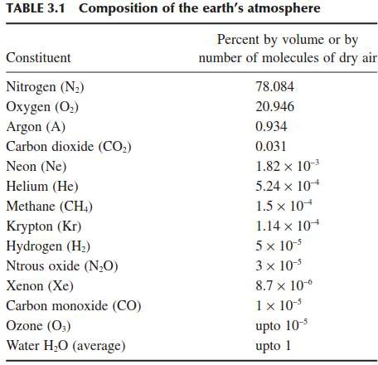
Air as an Insulating Medium
However, air is the most important, freely available, and cheapest gaseous dielectric.
The atmospheric air is in fact a mixture of a number of gases.
Nitrogen is an electropositive gas whereas oxygen is an electronegative gas.
Page 5

Slide 6
Air as an Insulating Medium
The largest percentage content of atmospheric air is nitrogen (about 78%), which is an electropositive gas.
The second largest constituent is oxygen (about 20%), which is a very weak electronegative gas.
The content of hydrogen, an electronegative gas too, is so low (5 × 10⁻⁵ %) that for all practical purposes the air can be considered as an electropositive gas.
Much theoretical as well as experimental research work, available in literature, has been performed on air to study the complicated discharge processes in gaseous dielectrics.
That is why scientists have chosen air to develop a “model of discharge” or more appropriately termed as “breakdown mechanisms ” for gaseous dielectrics.
Page 6

Slide 7
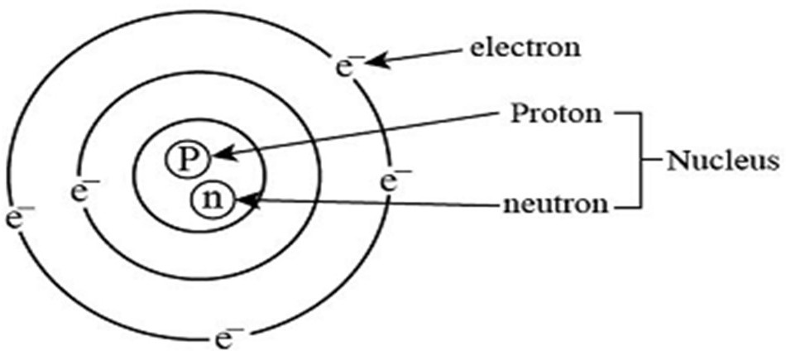
Energy Band Theory
An atom consists of a nucleus that contains protons (positively charged particles) and neutrons (having no charge).
The electrons revolve around the stationary nucleus in orbits or shells. These are also referred as energy states.
The last band containing electrons in an atom is called valence band.
The first unfilled level above the valence band is called conduction band.
The electrons in the valence band do not participate in the conduction process, they have to be present in the conduction band.
Page 7

Slide 8
Energy Band Theory
In insulators, all electrons lie in the valence band and the energy gap between the valence band and conduction band is too large for electrons to occupy higher energy levels when a potential difference is applied.
However, when a sufficiently high potential difference is applied to an insulator, the electrons jump from valence band to the conduction band. This makes an insulator a conductor and the phenomenon is called breakdown of an insulator.
The total energy of an electron, while still attached to the molecule, can be divided into two types of energies:
Kinetic energy
Potential energy
Page 8

Slide 9
Energy Band Theory
When an electron gets ejected out of an atom shell, the potential energy of the electron tends to be zero. Then the only energy it has is externally-acquired kinetic energy.
This is the amount of energy required for releasing an electron from its molecule. Hence, it is known as ionization energy of an electron.
In insulating gases (also called electron-attaching gases), the process of attachment also plays an important role.
If a free electron is absorbed by a molecule, forming a negative ion, this energy is released, known as “energy of recombination”.
Page 9

Slide 10
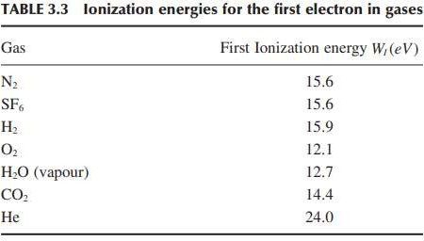
Energy Band Theory
Page 10

Slide 11
Ionization Processes
At normal temperature and pressure, the gases are excellent insulators. However, when a high voltage is applied between the two electrodes immersed in a gaseous medium, the gas becomes a conductor, and an electrical breakdown occurs.
The process by electrons and ions are produced from neutral atoms or molecules, which migrate towards the anode and cathode respectively, leading to the build-up of high current is called ionization.
The processes that are primarily responsible for the breakdown of a gas are:
Primary ionization or α-processes
Secondary ionization or ɣ-processes

Slide 12
Ionization Processes
Ionization may take place within the gas, that is, the multiplication of charge carriers may take place due to ionization within the gas medium. These are known as primary ionization processes.
At the same time, ionization may also take place at the electrodes. These are known as secondary ionization processes.

Slide 13
Ionization Processes
The primary ionization processes are further classified as:
Ionization by collision
Photo-ionization and interaction of metastables with molecules
Thermal ionization

Slide 14
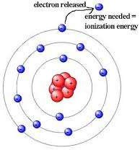
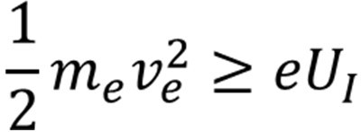
Ionization by Collision
The process of liberating an electron from a gas molecule with the simultaneous production of a positive ion is called ionization.
In the process of ionisation by collision, a free electron collides with a neutral gas molecule and gives rise to a new electron and a positive ion.

Slide 15

Ionization by Collision
Under applied field, any electron starting at the cathode will be accelerated more and more between collisions with other gas molecules during its travel towards the anode.
If the energy (ε) gained during this travel between collisions exceeds the ionisation potential, V_{i}, which is the energy required to dislodge an electron from its atomic shell, then ionisation takes place. This process can be represented as:
where, A is the atom, A⁺ is the positive ion and e⁻ is the electron.
A few of the electrons produced at the cathode by some external means, say by ultra-violet light falling on the cathode, ionise neutral gas particles producing positive ions and additional electrons.

Slide 16
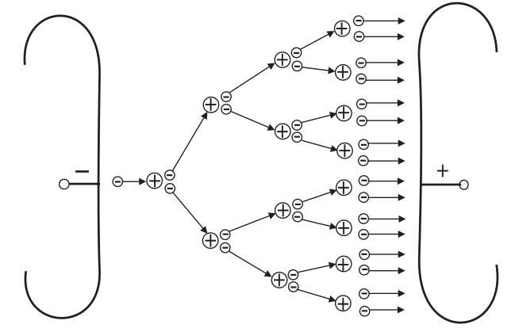
Ionization by Collision
The additional electrons, then, themselves make 'ionising collisions' and thus the process repeats itself.
This represents an increase in the electron current, since the number of electrons reaching the anode per unit time is greater than those liberated at the cathode.
In addition, the positive ions also reach the cathode and on bombardment on the cathode give rise to secondary electrons.

Slide 17
Photo-ionization and Interaction of Metastables with Molecules
The ionization by radiation or photons involves the interaction of radiation with matter.
The ionization by collision occurs when the energy exchanged in collision is more than the energy required for ionization.
However, the electrons having energy lower than the ionization energy may excite the gas molecules to higher energy states on collision. Under this condition, an electron is raised from a lower energy level to a higher one.
On recovering from the excited state in 10⁻⁷ to 10⁻¹⁰ sec., a molecule radiates a quantum of energy of photon (hν).
This energy in turn may ionize another molecule whose ionization potential energy is equal to or less than the photon energy. This process is known as photoionization.

Slide 18
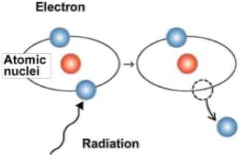
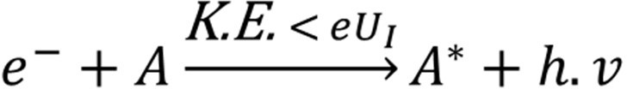

Photo-ionization and Interaction of Metastables with Molecules
The process of photoionization is represented as:
where A and B represent a neutral atom or molecule in the gas and h.ν is the photon energy.
If the photon energy is less than ionization energy , it may still be absorbed by the molecule and rise to a higher energy level. This process is known as photoexcitation.

Slide 19

Photo-ionization and Interaction of Metastables with Molecules
The life time of certain elements (such as Ne, He) in some of the excited electronic states extends to few tens of milliseconds (10 ⁻³ s) compared to the lifetime of an ordinary particle (10 ⁻⁸ s). These are known as metastable states and these atoms are known as metastables.
Metastables have a relatively high potential energy and are, therefore, able to ionize neutral particles.
Let A be the atom to be ionized and B^{m} the metastable, when B^{m} collides with A, ionization may take place according to the reaction:
Ionization by metastable interactions comes into operation long after excitation.

Slide 20
Photo-ionization and Interaction of Metastables with Molecules
However, the photons released by this reaction have too low an energy level to cause ionization in pure gases.
They may release electrons on striking the cathode. This process is known as the cathode emission or secondary ionization.
Page 20

Slide 21
Thermal Ionization
When a gas is heated to high temperature (to the order of 10,000 K and above), some of the gas molecules acquire high kinetic energy and these particles after collision with neutral particles ionize them and release electrons.
These electrons and other high-velocity molecules in turn collide with other particles and release more electrons. Thus, the gas gets ionized.
During electrical breakdown in gases, thermal ionization has its significance only towards the final stage of breakdown.
Because of the transformation of large amount of energy in the electrically conductive channel (known as leader) towards the final stage of breakdown, an exceptionally high temperature rise in the core of the leader channel is possible.
Thermal ionization is the principal source of ionization in arcs and flames.

Slide 22
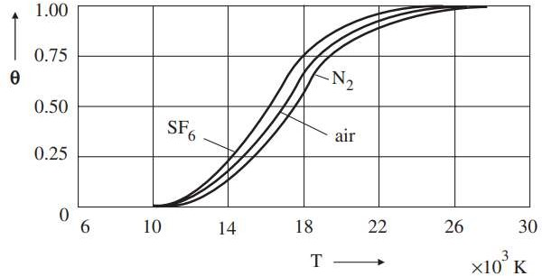
Thermal Ionization
Degree of ionization (θ) of thermally ionized gases at 1 bar

Slide 23
Secondary Ionization Processes
Secondary ionisation processes by which secondary electrons are produced are the one which sustain a discharge after it is established due to ionisation by collision, and photo-ionization.
Cathode plays an important role in gas discharges by supplying electrons for the initiation, sustainance and completion of a discharge.
In a metal, under normal condition, electrons are not allowed to leave the surface as they are tied together due to the electrostatic force between the electrons and the ions in the lattice.
The energy required to knock out an electron from a Fermi level is known as the work function (Φ) and is a characteristic of a given material.

Slide 24
Secondary Ionization Processes
There are various ways in which this energy can be supplied to release the electron:
Electron emission due to positive ion
Electron emission due to excited atom bombardment and photons
Thermionic emission
Field emission

Slide 25

Electron Emission due to Positive Ion
Positive ions are formed due to ionisation by collision or by photo-ionisation, and being positively charged, they travel towards the cathode.
A positive ion approaching a metallic cathode can cause emission of electrons from the cathode by giving up its kinetic energy on impact.
If the total energy of the positive ion, namely, the sum of its kinetic and potential energy, is greater than twice the work function of the metal, then one electron will be ejected and a second electron will neutralise the positive ion.
The electron emission by positive ion is the principal secondary process in the Townsend spark discharge mechanism.

Slide 26
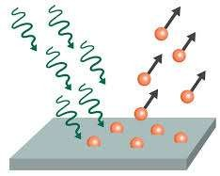
Electron Emission due to Excited Atom Bombardment and Photons
To cause an electron to escape from a metal, it should be given enough energy to overcome the surface potential barrier. This may happen in two ways:
Neutral excited atoms or molecules (metastables) incident upon the cathode surface are also capable of releasing electron from the surface.
The energy can also be supplied in the form of a photon of ultraviolet light of suitable frequency.
Electron emission from a metal surface occurs at the critical condition:
where φ is the work function of the metallic electrode.

Slide 27
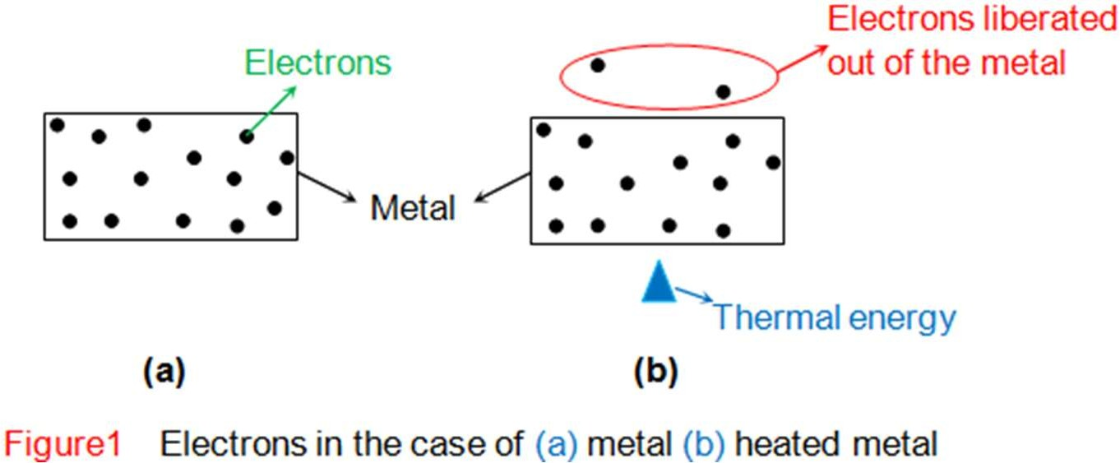
Thermionic Emission
At room temperature, the conduction electrons of the metal do not have sufficient thermal energy to leave the surface.
However, if the metals are heated to temperature 1500 K and above, the electrons will receive energy from the violent thermal lattice in vibration sufficient to cross the surface barrier and leave the metal.
Normally metals with low work function are used as cathode for thermionic emission.

Slide 28
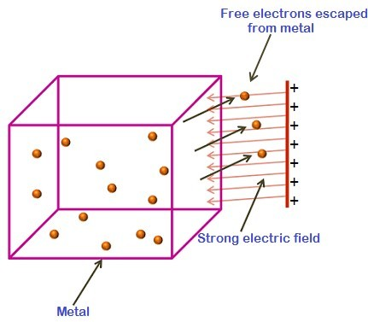
Field Emission
If a strong electric field is applied between the electrodes, the effective work function of the cathode decreases.
This is known as Schottky effect and holds good over a wide range of temperature and electric fields.
Calculations have shown that at room temperature the total emission is still low even when fields of the order of 10⁵ V/cm are applied.
However, if the field is of the order of 10⁷ V/cm, the emission current has been observed to be much larger than the calculated thermionic value

Slide 29
THANK YOU FOR YOUR ATTENTION

